Slide 1
Chongqing University of Technology
ATAI
Advanced Technique of Artificial Intelligence
Chongqing University of Technology
Relation of Relation Learning Network for Sentence Semantic Matching
Kun Zhang†, Le Wu†‡, Guangyi Lv§, Meng Wang†‡*, Enhong Chen§, Shulan Ruan§
†School of Computer Science and Information Engineering, Hefei University of Technology
‡Institute of Artificial Intelligence, Hefei Comprehensive National Science Center
§Anhui Province Key Laboratory of Big Data Analysis and Application, University of Science and Technology of China
{zhang1028kun, lewu.ustc, eric.mengwang}@gmail.com, {gylv,slruan}@mail.ustc.edu.cn, cheneh@ustc.edu.cn
——AAAI2021
2021.2.2 • ChongQing
Reported by Sijin Liu

Slide 2
Chongqing University of Technology
ATAI
Advanced Technique of Artificial Intelligence
Chongqing University of Technology
1.Introduction
2.Method
3.Experiments
4.Conclusion

Slide 3
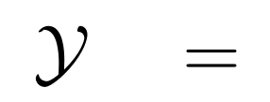
Introduction
Sentence semantic matching
Most of these models treat output labels as meaningless one-hot vectors, underestimating the semantic information and guidance of relations that these labels reveal, especially for tasks with a small number of labels.
Relation of Relation Classification
Notes:
在对话系统中，对话行为识别和情感分类是两个相关任务，能够帮助进行识别说话者的意图。其中，对话行为能够展示说话者显式的意图，而情感能展现说话者隐式的意图 [1]。
更具体的来说，对话行为识别和对话情感分类都可以看作是分类任务，目标是将对话中的每条语句标注上对应的DA标签和SC标签。
直观上，有两个关键因素有助于对话行为识别和情感预测。一个是跨任务的相互交互信息mutual interaction information，另一个是对话中的上下文信息context information。
如图3所示，前人的联合建模工作中，Cerisara等人[1]专注于相互交互信息（图3左），Kim等人[2]专注于对话历史信息（图3右）。最近，Qin等人[3]提出DCR-Net模型，虽然取得了较好效果，但是该模型却是以一种pipeline的方式来获取两种信息：在Encoder端获取对话历史信息，在relation layer端获取交互信息。但是我们认为，该类流水线式的模型存在一个问题： 两种信息是单独建模的。
所以接下来的问题是： 我们是否可以在一个统一的框架中同时对相互交互信息和上下文信息建模，来将它们完全整合呢？

Slide 4
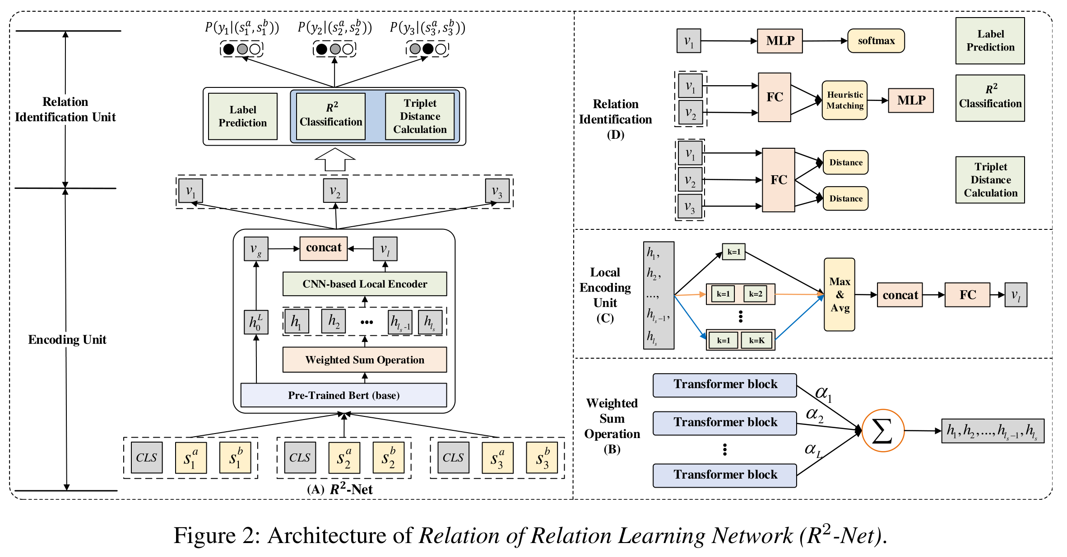
Method
Notes:
如图所示，这是模型的整体框架。由三部分组成，第一部分为分层对话者感知编码器；第二部分为核心模块——协同图交互层；第三部分为解码器部分。将在以下部分中作详细介绍。

Slide 5
Method
Sentence Semantic Matching Part
Global Encoding
Local Encoding
Label Prediction

Slide 6
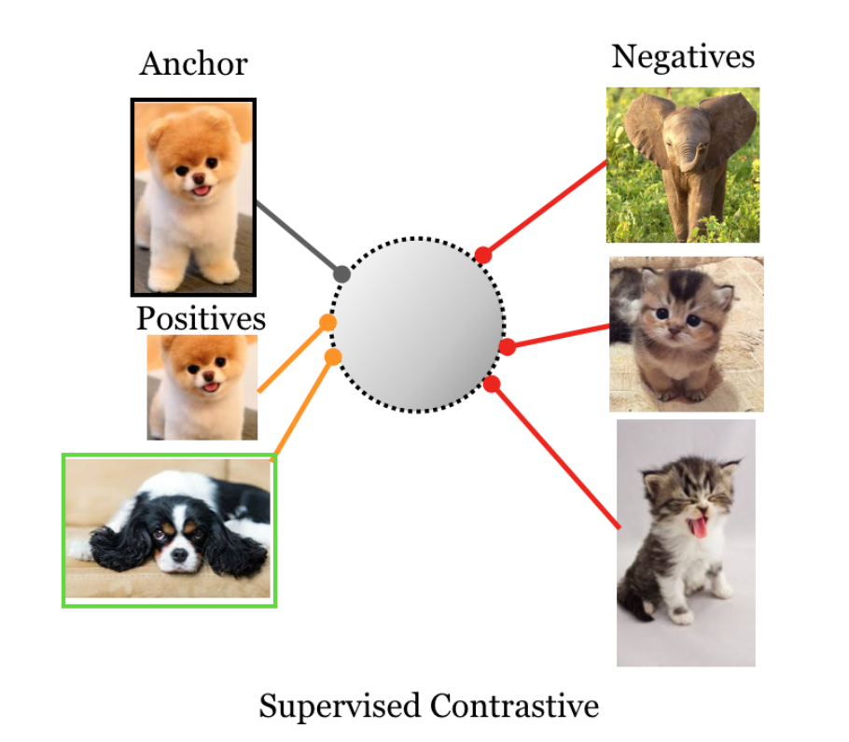
Method
Relation of Relation Learning Part
Relation of Relation Classification
Triplet Distance Calculation
Supervised Contrastive Learning
Notes:
首先，由公式3计算出hi邻接节点hj的重要性，然后通过公式2获取attention分数，最后使用求和的方式得到节点更新后的表示。这里我们还引入了多头注意力机制。

Slide 7
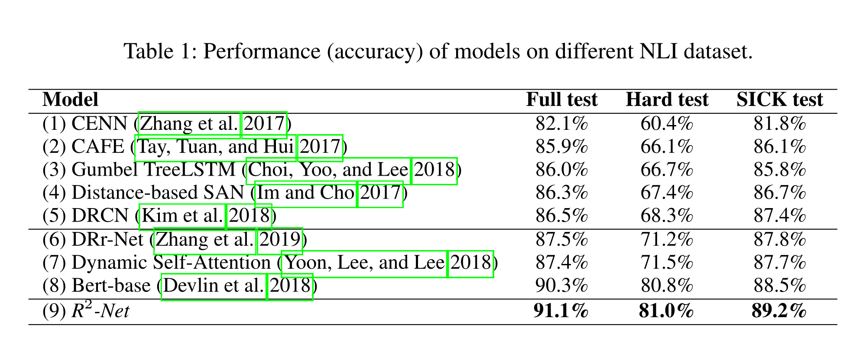
Experiments

Slide 8
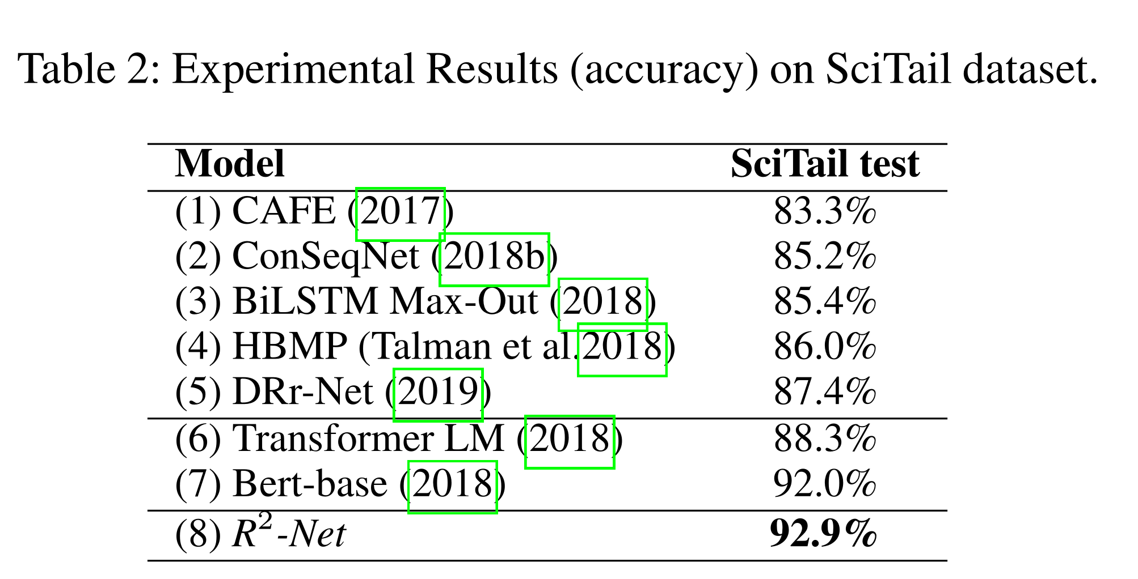
Experiments

Slide 9
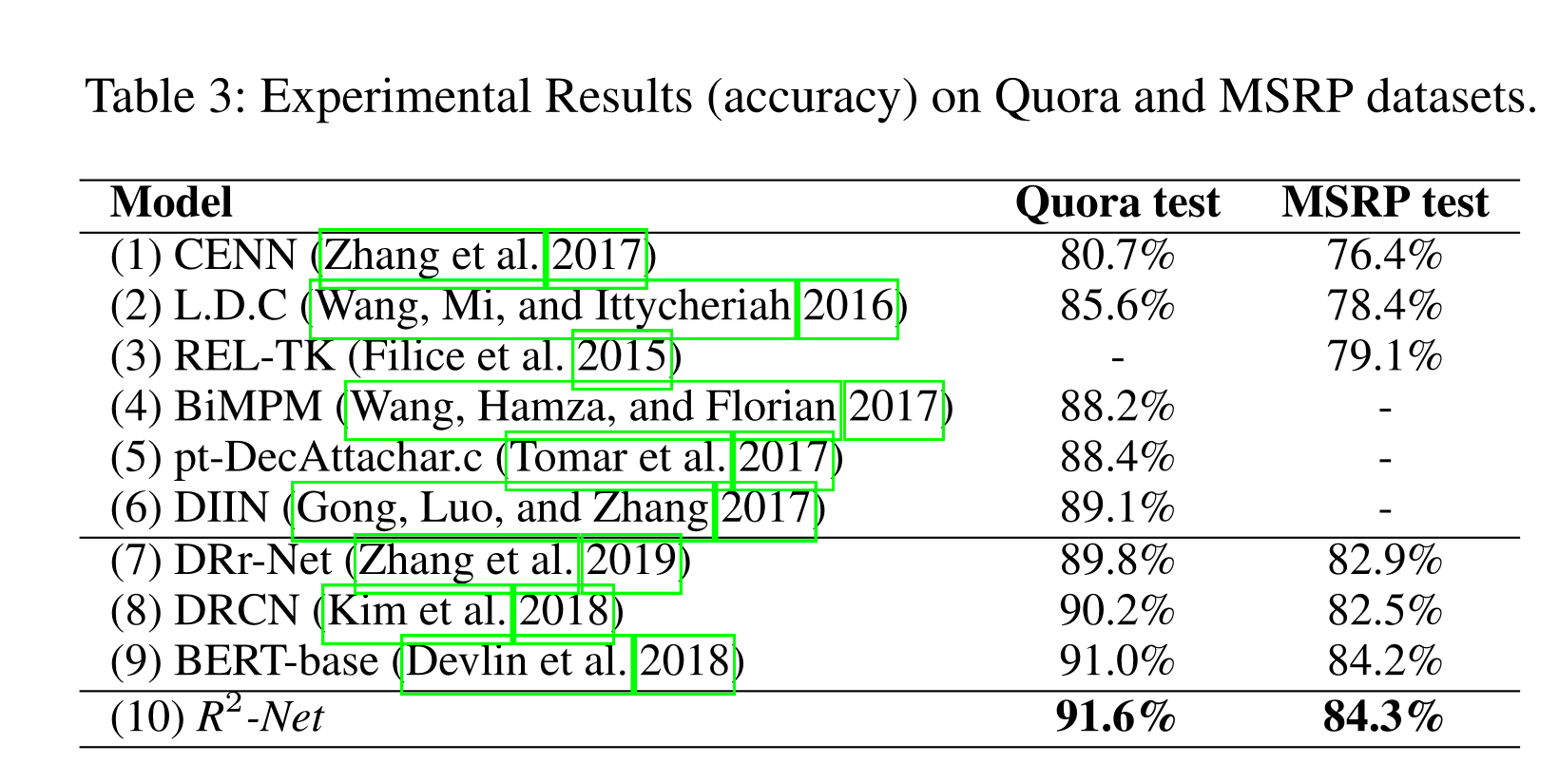
Experiments

Slide 10
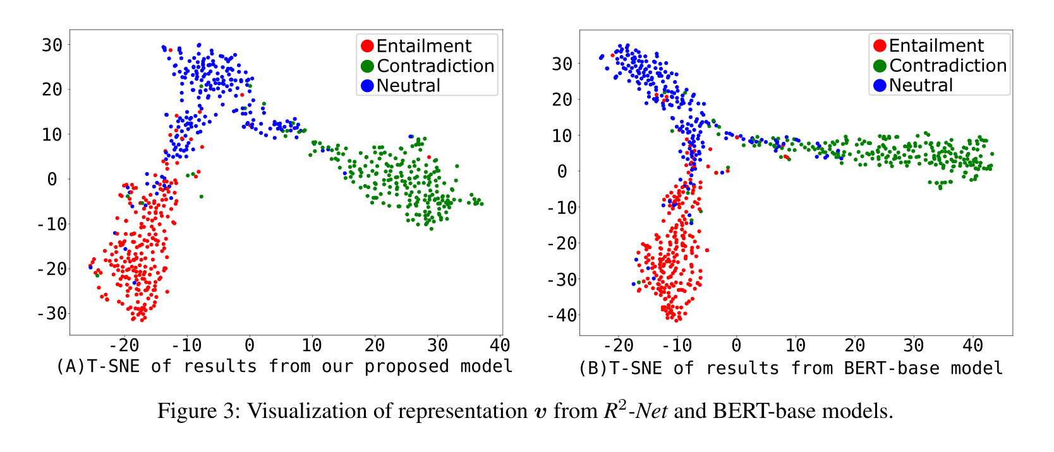
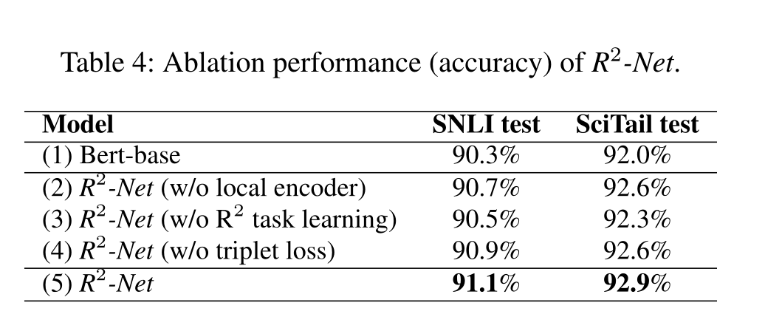
Experiments

Slide 11
Summary
In this paper, we presented a simple but effective method named R2-Net for sentence semantic matching. This method not only uses powerful BERT and CNN to encode sentences from global and local perspectives, but also makes full use of relation information for better performance enhancement. Specifically, we design a R2classification task to help R2-Net for learning the implicit common knowledge from the pairwise relation learning processing. Moreover, a triplet loss is employed to constrain R2-Net for better triplet based relation learning and intra-class and inter-class information analyzing. Extensive experiments on NLI and PI tasks demonstrate the superiority ofR2-Net. In the future, we plan to combine the advantages of label embedding method for better sentence semantic comprehension.

Slide 12
Thank you!

